Slide 1
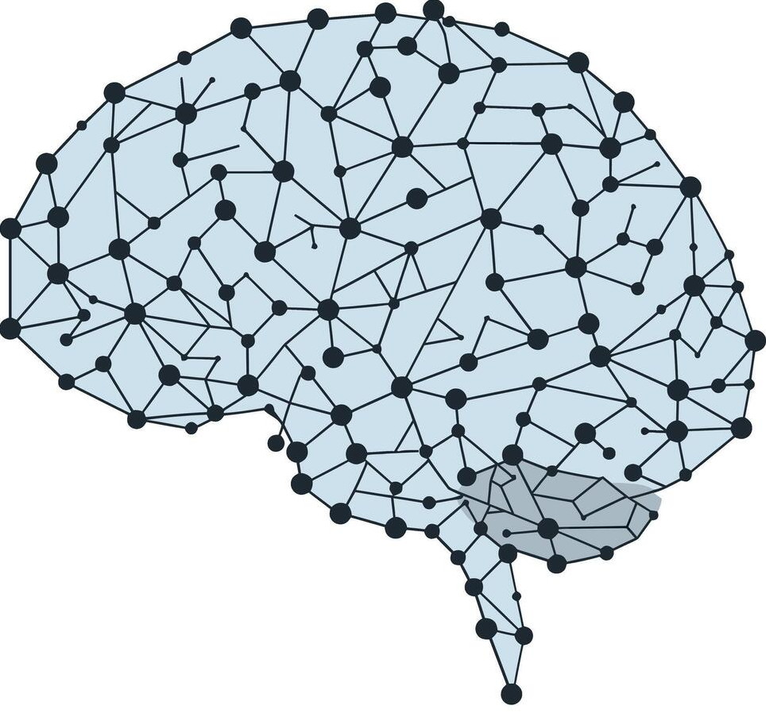
Machine Learning
Artificial Neural Networks Notes

Slide 2
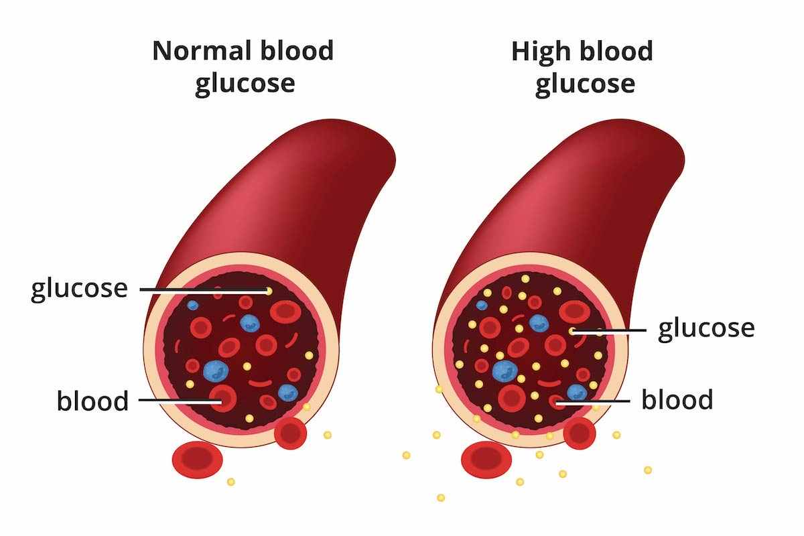
Use Case – Type-2 Diabetes Factor Investigation
Weight
Age
Height
Gender
Pregnancies
Glucose
Insulin
Blood Pressure
Skin Thickness
Genetics (DPF)
Levels of Stress/Anxiety
Why this happens?
Liver Fat
These our some of the factors that cause type-2 Diabetes.

Slide 3
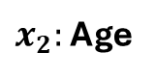
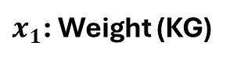
A Simplified Use Case
Weight
Age
Height
Gender
Positives
$x_{2}:$ Age
Negatives
100
Pregnancies
Glucose
Insulin
Blood Pressure
50
Skin Thickness
Genetics (DPF)
Levels of Stress/Anxiety
Liver Fat
$x_{1}$: Weight (KG)
0
50
100

Slide 4
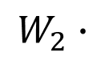
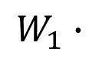
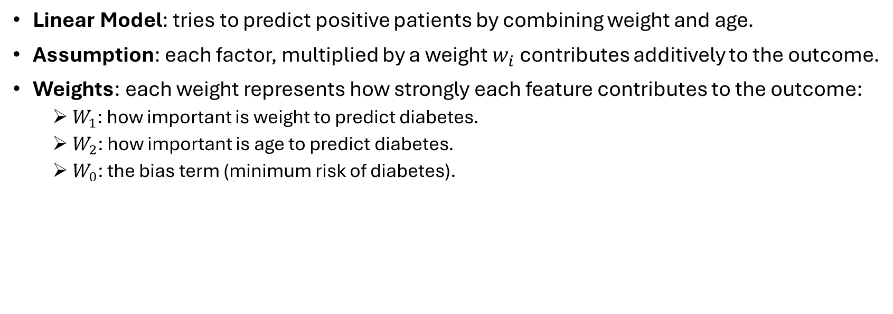
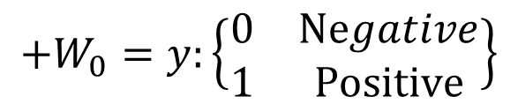
Linear Combination
Weight
Age
$$+W_{0}=y:\left\{\begin{matrix}0 & Negative \\ 1 & Positive\end{matrix}\right\}$$
$$W_{1}∙$$
$$W_{2}∙$$
Linear Model: tries to predict positive patients by combining weight and age.
Assumption: each factor, multiplied by a weight $w_{i}$ contributes additively to the outcome.
Weights: each weight represents how strongly each feature contributes to the outcome:
$W_{1}$: how important is weight to predict diabetes.
$W_{2}$: how important is age to predict diabetes.
$W_{0}$: the bias term (minimum risk of diabetes).

Slide 5
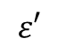
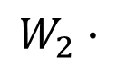
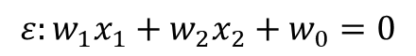
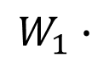
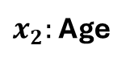
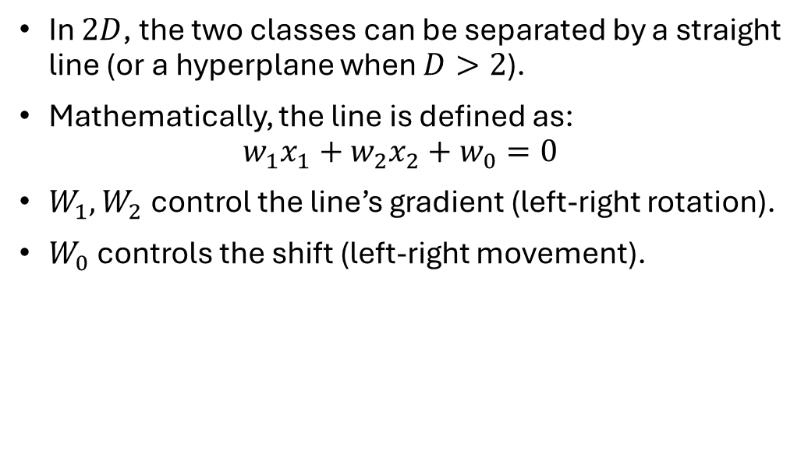
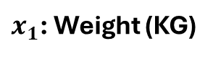
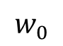
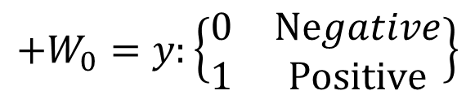
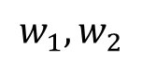
Visualization of Linear Model
Weight
Age
$$+W_{0}=y:\left\{\begin{matrix}0 & Negative \\ 1 & Positive\end{matrix}\right\}$$
$$W_{1}∙$$
$$W_{2}∙$$
Positives
In $2D$, the two classes can be separated by a straight line (or a hyperplane when $D>2$).
Mathematically, the line is defined as: $w_{1}x_{1}+w_{2}x_{2}+w_{0}=0$
$W_{1},W_{2}$ control the line’s gradient (left-right rotation).
$W_{0}$ controls the shift (left-right movement).
$x_{2}:$ Age
$$ε′$$
Negatives
$$w_{1},w_{2}$$
$$w_{0}$$
50
$$ε:w_{1}x_{1}+w_{2}x_{2}+w_{0}=0$$
$x_{1}$: Weight (KG)
0
50
100
Geometrical Definition

Slide 6
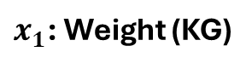
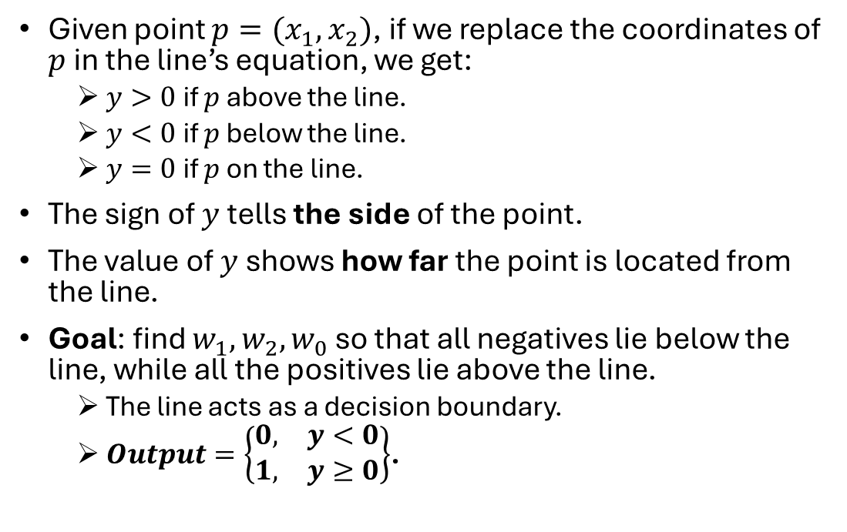
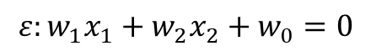
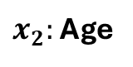
Geometrical Definition of Linear Model
Given point $p=(x_{1},x_{2})$, if we replace the coordinates of $p$ in the line’s equation, we get:
$y>0$ if $p$ above the line.
$y<0$ if $p$ below the line.
$y=0$ if $p$ on the line.
The sign of $y$ tells the side of the point.
The value of $y$ shows how far the point is located from the line.
Goal: find $w_{1},w_{2},w_{0}$ so that all negatives lie below the line, while all the positives lie above the line.
The line acts as a decision boundary.
$Output=\left\{\begin{matrix}0, & y<0 \\ 1, & y≥0\end{matrix}\right\}$.
$x_{2}:$ Age
Positives
Negatives
50
$$ε:w_{1}x_{1}+w_{2}x_{2}+w_{0}=0$$
$x_{1}$: Weight (KG)
0
50
100

Slide 7
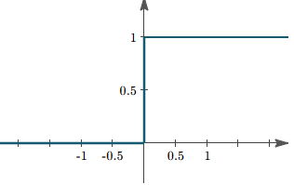
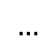
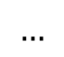
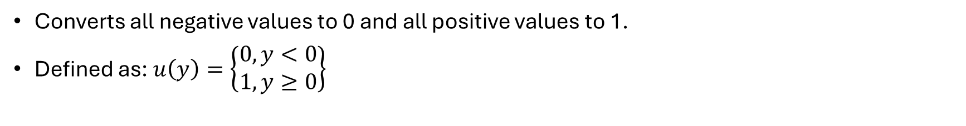
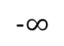
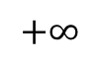
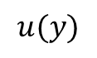
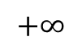
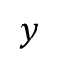
Step Function
Converts all negative values to 0 and all positive values to 1.
Defined as: $u\left(y\right)=\left\{\begin{matrix}0, y<0 \\ 1, y≥0\end{matrix}\right\}$
$$+∞$$
$$u(y)$$
$$…$$
$$y$$
$$−∞$$
$$…$$
$$…$$
$$+∞$$

Slide 8
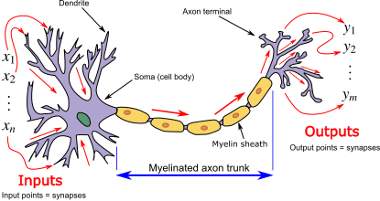
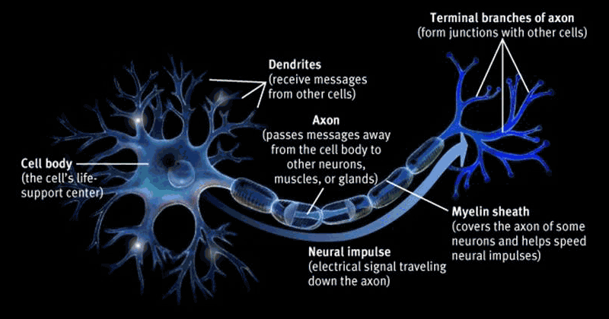
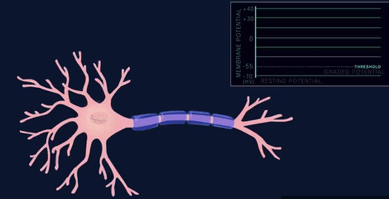
Biological Neuron Model

Slide 9
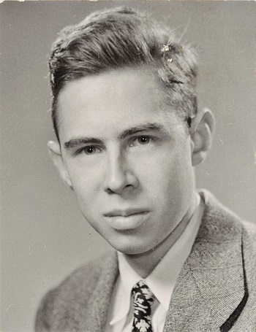
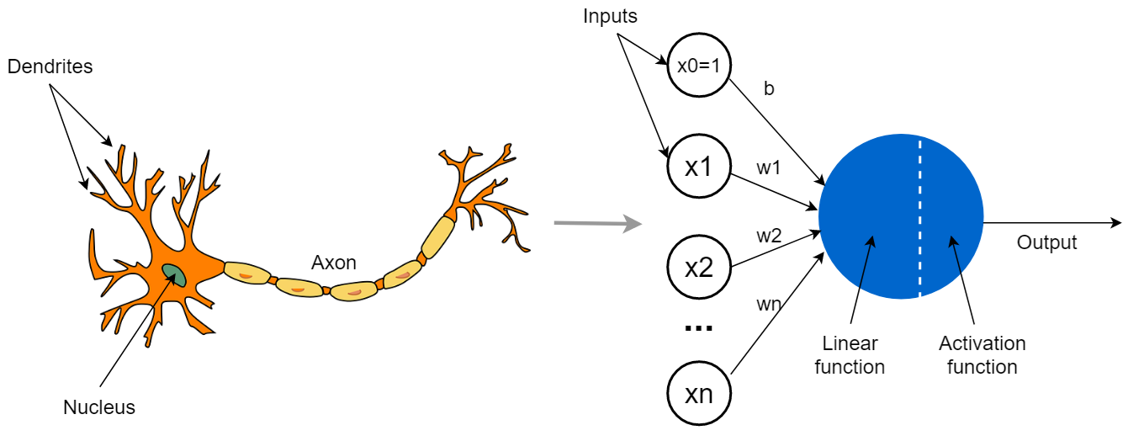
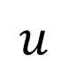
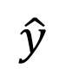
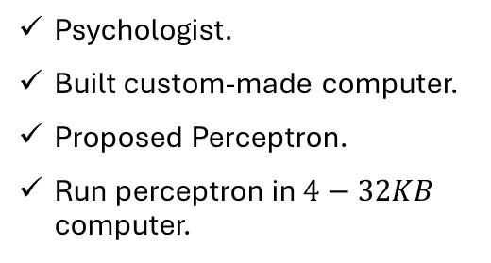
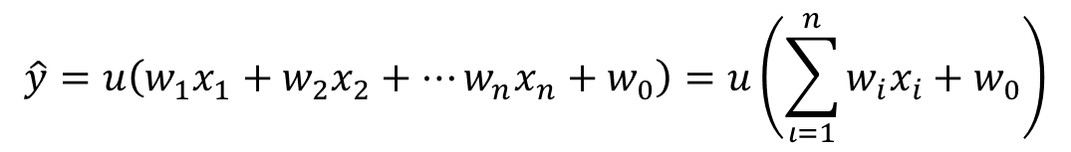

Perceptron
$$Σ$$
$$\hat{y}$$
$$u$$
Frank Rosenblatt, 1957
Psychologist.
Built custom-made computer.
Proposed Perceptron.
Run perceptron in $4−32KB$ computer.
$$\hat{y}=u\left(w_{1}x_{1}+w_{2}x_{2}+…w_{n}x_{n}+w_{0}\right)=u\left(\sum_{ι=1}^{n}{w_{i}x_{i}}+w_{0}\right)$$
Linear Model
If enough voltage is gathered, the neuron cell is activated (activation function) and propagates the signals to other neurons.

Slide 10
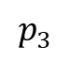
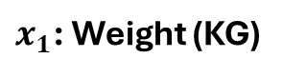
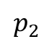
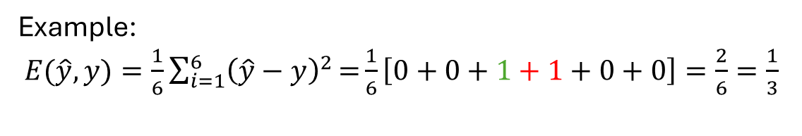
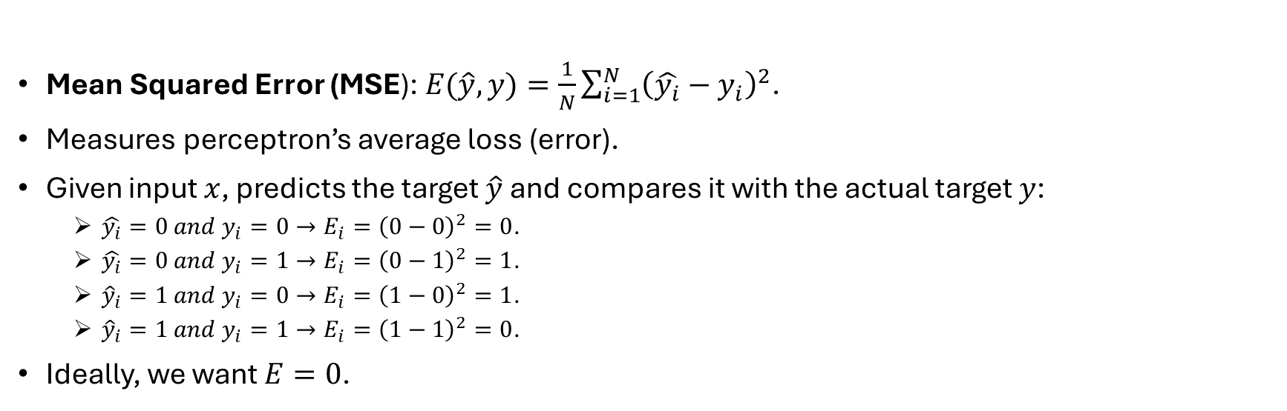
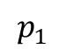
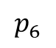
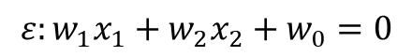
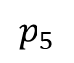
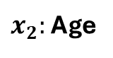

Perceptron’s Loss Function
Mean Squared Error (MSE): $E(\hat{y},y)=\frac{1}{N}\sum_{i=1}^{N}{{\left(\hat{y_{i}}−y_{i}\right)}^{2}}$.
Measures perceptron’s average loss (error).
Given input $x$, predicts the target $\hat{y}$ and compares it with the actual target $y$:
$\hat{y_{i}}=0 and y_{i}=0→E_{i}={\left(0−0\right)}^{2}=0$.
$\hat{y_{i}}=0 and y_{i}=1→E_{i}={\left(0−1\right)}^{2}=1$.
${\hat{y}}_{i}=1 and y_{i}=0→E_{i}={\left(1−0\right)}^{2}=1$.
${\hat{y}}_{i}=1 and y_{i}=1→E_{i}={\left(1−1\right)}^{2}=0$.
Ideally, we want $E=0$.
$x_{2}:$ Age
Positives
Negatives
$$p_{4}$$
$$p_{5}$$
$$p_{6}$$
50
$$p_{1}$$
$$ε:w_{1}x_{1}+w_{2}x_{2}+w_{0}=0$$
Example: $E(\hat{y},y)=\frac{1}{6}\sum_{i=1}^{6}{{\left(\hat{y}−y\right)}^{2}}\text{=}\frac{1}{6}\left[0+0+1+1+0+0\right]=\frac{2}{6}=\frac{1}{3}$
$$p_{2}$$
$$p_{3}$$
$x_{1}$: Weight (KG)
0
50
100

Slide 11









Perceptron’s Limitation (1)
In this example $E=0$.
Question: Is this classification boundary well-defined?
$x_{2}:$ Age
Positives
$$ε$$
Negatives
$$p_{3}$$
50
$$p_{5}$$
$$p_{1}$$
$$p_{6}$$
$$p_{2}$$
$$p_{4}$$
$x_{1}$: Weight (KG)
0
50
100

Slide 12











Step Function Limitation
$x_{2}:$ Age
Positives
Outputs only Perceptron’s decisions.
Even though $E=0$, it does not tell how well the boundary decision is placed.
No probability is calculated, even though some points are closer to the decision boundary.
It is obvious that $ε′$ has a higher probability to classify both positive and negative instances correctly.
$$ε′$$
$$ε$$
Negatives
$$p_{3}$$
50
$$p_{5}$$
$$p_{1}$$
$$p_{6}$$
$$p_{2}$$
$$p_{4}$$
$x_{1}$: Weight (KG)
0
50
100

Slide 13


Alternative Activation Functions
Given $z=\sum_{ι=1}^{n}{w_{i}x_{i}}+w_{0}$, then:
Sigmoid $σ(z)$: Converts perceptron’s output to probability (Logistic Regression, 1944).
Perceptron can be though as a generalized Logistic Regression model.
$\hat{y}=\left\{\begin{matrix}0, & σ\left(z\right)<0.5 \\ 1 & σ\left(z\right)≥0.5\end{matrix}\right\}$.
Tanh $φ(z)$: Converts output in $[−1.0, 1.0]$.
It is centered around 0.0 $→$ better classification performance.
$\hat{y}=\left\{\begin{matrix}−1, & φ\left(z\right)<0 \\ 1 & φ\left(z\right)≥0\end{matrix}\right\}$.
ReLU (Rectified Linear Unit) $r(z)$: $\hat{y}=\left\{\begin{matrix}0, & r\left(z\right)<0 \\ z & r\left(z\right)≥0\end{matrix}\right\}$.
Extremely fast activation function.
Is not differentiable for all $z<0$.
Leaky ReLU: $\hat{y}=\left\{\begin{matrix}αz, & r\left(z\right)<0 \\ z & r\left(z\right)≥0\end{matrix}\right\}$, where $a$ small constant. Is differentiable for all $z<0$.

Slide 14





Perceptron for Regression Tasks
In these tasks, the goal of the perceptron is to fit the line on the given points.
It removes the activation function
Or as they say, uses linear activation function: $f\left(z\right)=z$.
It becomes a linear regression model.
Perceptron
$$\hat{y}$$
$$Σ$$

Slide 15









Optimization Algorithm (Neuron Training)
$$x_{2}$$
$$w_{i}$$
Given weights $W=\left(w_{1},w_{2},w_{3},w_{0}\right)$, changing a weight $w_{i}$ will result in different decision boundary (e.g., the line will be rotated).
In turn, the error $E(w_{i})$ might increase or decrease.
Goal: Change the values of $W$ so that $E(w_{i})→0$.
Question: How can I know in advance in which direction I should move the value of $w_{i}$, so that $E(w_{i})$ is minimized?
Alternatively, how can I know if $E$ increases or decreases if I slightly increase $w_{i}$?
$$x_{1}$$
$$E(w_{i})$$
$$1$$
$$0$$
$$0.35$$
$$W_{i}$$

Slide 16














Derivative of Error with Respect to Weights
$$E(w_{i})$$
$$1$$
Assuming that $h$ is a very small step on the right $\left(h→0\right).$
$\frac{dE(w_{i})}{dw_{i}}=E^{′}\left(w_{i}\right)=\lim_{h→0}{\frac{E\left(w_{i}+h\right)−E(w_{i})}{(w_{i}+h)−w_{i}}=\lim_{h→0}{\frac{E\left(w_{i}+h\right)−E(w_{i})}{h}}}$
The derivative $\frac{dE}{dw_{i}}$ tells in which direction $E(w_{i})$ changes (slope/gradient).
By Euclidean Geometry, $\tan\left(φ\right)=\frac{sin⁡(φ)}{cos⁡(φ)}=\frac{y}{x}$, where $y$ is the vertical difference (of $E(w_{i}))$ and $x$ is the horizontal difference (of $w_{i})$.
Question: How can I compute the value of $E\left(w_{i}+h\right)$ if $E(w_{i})$ and $\frac{dE}{dw_{i}}$ is known?
$$E(w_{i})$$
$$E(w_{i}+h)$$
$$0$$
$$0.35$$
$$0.35+h$$
$$W_{i}$$
$$y axis$$
$$\frac{dE}{dw}$$
$$E(w_{i})$$
$$φ$$
$$E(w_{i}+h)$$
$$x axis$$
$$w_{i}$$
$$w_{i}+h$$

Slide 17







Taylor Series
Since the gradient $\frac{dE}{dw}$ is know, we can compute error as follows: $E\left(w+h\right)=E\left(w\right)+h\frac{dE}{dw}$.
In this case, the gradient represents the direction in multiple spaces
$Gradient=Slope$ in $1D$ case. Since we have multiple weights $w$, $\frac{dE}{dw}$ provides the gradient.
However, the term $h\frac{dE}{dw}$ is linear, while $E$ is a curve, so there must be an error to $E\left(w+h\right).$
Solution: Compute the gradients of the gradient (2nd order derivative.
We can continue computing the derivatives to rectify the errors.
By Taylor: $E\left(w+h\right)=E\left(w\right)+h\frac{dE}{dw}+\frac{1}{2}h^{2}\frac{d^{2}E}{dw^{2}}+…=\sum_{i=0}^{n}{h^{n}\frac{E^{(n)}(w)}{h!}}$
$$E(w_{i})$$
$$1$$
$$\frac{dE}{dw}$$
$$E(w_{i})$$
$$E(w_{i}+h)$$
$$0$$
$$w_{i}$$
$$w_{i}+h$$
$$W_{i}$$

Slide 18

Gradient Descent Optimizer
Computing all the derivatives is expensive and not possible if multiple weights are involved.
Instead, we can assume that for very small $h (h→0)$ we can approximate $E(w+h)$ using the first-order derivative only (Euler’s approximation): $E\left(w+h\right)≈E\left(w\right)+h\frac{dE}{dw}$
Question: What should $w^{′}=w+h$ equal so that $E\left(w+h\right)≤E\left(w\right)+h\frac{dE}{dw}$?
In other words, how can I ensure that the left part of the equation will be smaller than the right part?
Note that $w$ is known. We must compute $h.$

Slide 19






Delta Rule (Update Rule)
$$E(w)$$
Given $h=−\frac{dE}{dw}$:
$$E\left(w−\frac{dE}{dw}\right)=E\left(w\right)−\left(\frac{dE}{dw}\right)\frac{dE}{dw}⇒E\left(w−\frac{dE}{dw}\right)=E\left(w\right)−{\left(\frac{dE}{dw}\right)}^{2}$$
Mathematically, ${\left(\frac{dE}{dw}\right)}^{2}≥0$ is always larger than 0 (positive).
By subtracting a $E\left(w\right)$ with a positive value, we $E(w)$.
This ensures that $E\left(w−\frac{dE}{dw}\right)≤$ $E\left(w\right)$, where $w−\frac{dE}{dw}$ is the new weight $w′$.
Delta Rule: $w^{′}=w−\frac{dE}{dw}$.
We can iteratively repeat the process $k$ times (epochs) until $E$ drops or converges close to 0.
Limitation: We assumed that $h→0$. If the gradient is large, then $E(w_{i})$ will diverge. We need to ensure $\frac{dE}{dw}$ is small.
Better Delta Rule: $w^{′}=w−α\frac{dE}{dw}$, where $α∈(0.0, 1.0)$ is the learning rate.
$$w$$
$E(w)$ is $z$ axis $w_{1},w_{2}$ are $x,y$axis

Slide 20



Learning Rate
It is proven that by setting the learning rate $α$ as a small constant (e.g., $a=0.001)$, Gradient Descent will steadily converge towards 0.
Oppositely, for larger $α$ values, it might be more challenging to converge.

Slide 21


Derivatives
$\frac{d}{dx}x=x′$ for single variable $x$.
$\frac{d}{dx}c=0$, where $c$ is a constant value.
$\frac{d}{dx}x=1$.
$\frac{d}{dx}x^{n}=nx^{n−1}$.
$\frac{d}{dx}\frac{1}{x^{n}}=\frac{d}{dx}x^{−n}=−nx^{−n−1}=−n\frac{1}{x^{n+1}}$.
$\frac{d}{dx}sin\left(x\right)=cos⁡(x)$.
$\frac{d}{dx}cos\left(x\right)=−sin⁡(x)$.
$\frac{d}{dx}e^{x}=e^{x}$
$\frac{d}{dx}ln⁡(x)=\frac{1}{x}$.
$\frac{d}{dx}a^{x}=a^{x}\log_{e}a$.
$\frac{d}{dx}\sqrt{x}=\frac{1}{2\sqrt{x}}$.
$\frac{d}{dx}f\left(x\right)=f′(x)$ for functions with a single variable $x$.
Constant Multiple Rule: $\frac{d}{dx}c∙f\left(x\right)=c∙\frac{d}{dx}f\left(x\right)$.
Summation Rule: $\frac{d}{dx}\left(f\left(x\right)+g(x)\right)=\frac{d}{dx}f\left(x\right)+\frac{d}{dx}g\left(x\right)$.
Product Rule: $\frac{d}{dx}\left(f\left(x\right)g\left(x\right)\right)=\frac{df(x)}{dx}g\left(x\right)+\frac{dg\left(x\right)}{dx}f(x)$.
Quotient Rule:$\frac{d}{dx}\left(\frac{f\left(x\right)}{g(x)}\right)=\frac{\frac{df(x)}{dx}g\left(x\right) − \frac{dg\left(x\right)}{dx}f(x)}{g^{2}(x)}$.
Chain Rule: $\frac{d}{dx}f\left(g\left(x\right)\right)=f′(g\left(x\right))∙g′(x)$.

Slide 22

Gradient Descent Example
Given instance $x=(1,1)$ with class $y=1$ and Perceptron with weights $w_{1}=1, w_{2}=−1, w_{0}=0$ and sigmoid activation $σ(x)$, minimize $MSE(\hat{y},y)$ by applying Gradient Descent. It is also given that learning rate $α=0.1$ and $σ^{′}\left(x\right)=σ(x)(1−σ\left(x\right))$.
Compute predictions: $\hat{y}=σ\left(WX+w_{0}\right)=σ\left(1∙1−1∙1+0\right)=σ\left(2\right)=\frac{1}{1+e^{0}}=\frac{1}{2}=0.5$.
Compute Error: $E=MSE\left(\hat{y},y\right)={\left(0.5−1\right)}^{2}={\left(\frac{1}{2}\right)}^{2}=\frac{1}{4}$.
$\frac{dE}{dw_{i}}=\frac{d}{dw_{i}}{\left(\hat{y}−y\right)}^{2}$. This is the case of $\frac{d}{dx}f^{2}\left(x\right)=2f(x)∙\frac{d}{dx}f(x)$.
$\frac{dE}{dw_{i}}=2\left(\hat{y}−y\right)\frac{d}{dw_{i}}\left(\hat{y}−y\right)$. By the summation rule:
$\frac{dE}{dw_{i}}=\left[2\left(\hat{y}−y\right)\frac{d}{dw_{i}}\hat{y}\right]−\left[2\left(\hat{y}−y\right)\frac{d}{dw_{i}}y\right]$. Since $y$ is constant (0 or 1), then $\frac{d}{dw_{i}}y=0$.
$\frac{dE}{dw_{i}}=2\left(\hat{y}−y\right)\frac{d}{dw_{i}}\hat{y}=2\left(\hat{y}−y\right)\frac{d}{dw_{i}}σ(WX+w_{0})$. By the chain rule:
Given that $σ^{′}\left(x\right)=σ(x)(1−σ\left(x\right))$, then by chain rule: $σ\left(f\left(x\right)\right)=σ\left(f\left(x\right)\right)\left(1−σ\left(f\left(x\right)\right)\right)f′(x)$.

Slide 23

Gradient Descent Example
$\frac{dE}{dw_{i}}=2\left(\hat{y}−y\right)σ(WX+w_{0})(1−σ\left(WX+w_{0}\right))\frac{d}{dw_{i}}(WX+w_{0})$.
Finally, $\frac{dE}{dw_{i}}=2\left(\hat{y}−y\right)\hat{y}\left(1−\hat{y}\right)\frac{d}{dw_{i}}(w_{1}x_{1}+w_{2}x_{2}+w_{0})$. By the summation rule:
$\frac{d}{dw_{i}}\left(w_{1}x_{1}+w_{2}x_{2}+w_{0}\right)=\frac{d}{dw_{i}}w_{1}x_{1}+\frac{d}{dw_{i}}w_{2}x_{2}+\frac{d}{dw_{i}}w_{0}$
For $w_{1}$, all the above sum equals $x_{1}$, since $\frac{d}{dw_{1}}w_{1}x_{1}=x_{1}$ and all other weights, inputs are constants.
Similarly, $\frac{d}{dw_{2}}=x_{2}$ and $\frac{d}{dw_{0}}=1$.
$2\left(\hat{y}−y\right)\hat{y}\left(1−\hat{y}\right)=2\left(0.5−1\right)0.5\left(1−0.5\right)=−\frac{1}{4}$.
$\frac{dE}{dw_{1}}=−\frac{1}{4}x_{1}=−\frac{1}{4}=−0.25$, $\frac{dE}{dw_{2}}=−\frac{1}{4}x_{2}=−\frac{1}{4}=−0.25$, $\frac{dE}{dw_{0}}=−\frac{1}{4}1=−\frac{1}{4}=−0.25$.
By Gradient Descent: $w_{i}^{′}=w_{i}−α\frac{dE}{dw_{i}}$
$w_{1}^{′}=1−0.1\left(−0.25\right)=1+0.025=1.025$
$w_{2}^{′}=0.975$
$w_{0}=0.025$

Slide 24


Gradient Descent with Multiple Instances
The same process can be repeated for $N$ instances.
In this case, $E=\frac{1}{N}\left[{\left({\hat{y}}_{1}−y_{1}\right)}^{2}+{\left({\hat{y}}_{2}−y_{2}\right)}^{2}+…+{\left({\hat{y}}_{N}−y_{N}\right)}^{2})\right]$.
To calculate $\frac{dE}{dw_{i}}$, we can apply the summation rule.

Slide 25


Non-Linearly Separable Data
This category includes:
Classes which cannot be separated using a straight line.
Non-linear functions in regression.
Perceptron cannot fit on these data.

Slide 26






Real World Use Cases
Real world systems/phenomena are typically non-linear.
Non-linear observation present more complex patterns and require more complex modeling.
In the diabetes use-case, the observed instances are more likely to be appear as below.
Question: How can we create more complex boundaries (such as curves)?
$x_{2}:$ Age
$x_{2}:$ Age
$x_{2}:$ Age
Positives
Positives
Positives
Negatives
Negatives
Negatives
50
50
50
$x_{1}$: Weight (KG)
$x_{1}$: Weight (KG)
$x_{1}$: Weight (KG)
0
50
100
0
50
100
0
100
50

Slide 27






















Multi-Layer Perceptron (MLP)
$x_{2}:$ Age
Positives
Negatives
$$1$$
50
$$w_{1}^{(1)}$$
$x_{2}:$ Age
$$w_{11}^{(1)}$$
$$w_{1}^{(2)}$$
Positives
Weight: $x_{1}$
$$h_{1}$$
$x_{1}$: Weight (KG)
Negatives
$$w_{11}^{(2)}$$
0
50
100
$$w_{12}^{(1)}$$
$x_{2}:$ Age
$$u$$
50
$$w_{21}^{(1)}$$
$$w_{21}^{(2)}$$
Age: $x_{2}$
$$h_{2}$$
$x_{1}$: Weight (KG)
$$w_{22}^{(1)}$$
50
0
50
100
$$w_{2}^{(1)}$$
$$1$$
$x_{1}$: Weight (KG)
$w_{i,j}→$ Neuron $i$ is connected to $j$ of the next layer.
0
50
100

Slide 28

Multi-Layer Perceptron (MLP) Use Case
Each neuron applies a transformation of its input.
The transformed outputs of each neuron are gathered into a single final neuron that generates the predictions.
$w_{11}^{(1)}x_{1}+w_{21}^{(1)}x_{2}+w_{1}^{(1)}=h_{1}$.
$w_{12}^{(1)}x_{1}+w_{22}^{(1)}x_{2}+w_{2}^{(1)}=h_{2}$.
$w_{11}^{(2)}h_{1}+w_{21}^{(2)}h_{2}+w_{1}^{(2)}=u$.
Optionally, we can place activation functions at the output of each neuron:
$h_{1}^{′}=r(h_{1})$.
$h_{2}^{′}=r(h_{2})$.
$u^{′}=σ\left(u\right)$

Slide 29


Multi-Layer Perceptron Design
Definition: Neural Networks with at least one hidden layer.
Layers:
Input Layer
Hidden Layers
Output Layer
Each layer is also called “Dense” or “Linear”.
Typical MLPs are Feedforward Neural Networks:
Starting from the input layer, each neuron applies a transformations and passes it to the next layer’s neurons. The final layer is used to generate predictions.
Shallow Networks: Maximum 2 hidden layers.
Deep Neural Networks: More than 2 hidden layers, usually millions of parameters.

Slide 30




Deep Neural Networks (DNNs)
Works in 3 phases:
Feedforward: Propagates the inputs into the network and generates the predictions. Finally, it computes the error $E$ using the loss function.
Back-Propagation: It propagates the network’s error back to the previous weights by computing the gradients of the error $\frac{dE}{dw_{i}}$ with respect to each weight $w_{i}$.
It has been proved that this can easily be achieved by applying the chain rule.
Modern Multilayer Neural Networks: David Rumelhart, Geoffrey Hinton, and Ronald Williams (1986)

Slide 31












































Back-Propagation Example
$$w_{1}^{(1)}$$
$$w_{1}^{(2)}$$
$$w_{11}^{(1)}$$
$$w_{11}^{(2)}$$
$${\hat{y}}_{1}$$
$$x_{1}$$
$$h_{1}$$
$$o_{1}$$
The following MLP applies sigmoid activations at $o_{1}$ and $o_{2}$ outputs and ReLU at $h_{1},h_{2}$. Compute the gradients of $w_{11}^{(2)}$, $w_{11}^{(1)},w_{22}^{(1)}$using the $MSE(\hat{y},y)$ as loss function, if $h_{1}^{′}=r\left(h_{1}\right)>0$ and $h_{2}^{′}=r\left(h_{2}\right)=0$.
--- Feedforward ---
$h_{1}=r(w_{11}x_{1}+w_{21}x_{2}+w_{1}^{(1)})$, $h_{2}=r(w_{12}x_{1}+w_{22}x_{2}+w_{2}^{(1)})$.
${\hat{y}}_{1}=σ\left(h_{1}w_{11}^{\left(2\right)}+h_{2}w_{21}^{\left(2\right)}+w_{1}^{\left(2\right)}\right),{\hat{y}}_{2}=σ\left(h_{1}w_{12}^{\left(2\right)}+h_{2}w_{22}^{\left(2\right)}+w_{2}^{\left(2\right)}\right)$.
--- Back-Propagation ---
$\frac{dE}{dw_{11}^{(2)}}=\frac{d}{dw_{11}^{\left(2\right)}}\left(E_{1}+E_{2}\right)=\frac{d}{dw_{11}^{\left(2\right)}}E_{1}+\frac{d}{dw_{11}^{\left(2\right)}}E_{2}$.
Since the term $w_{11}^{(2)}$ is not inside $E_{2}$, then $E_{2}$ is constant $→\frac{d}{dw_{11}^{\left(2\right)}}E_{2}=0$.
$\frac{d}{dw_{11}^{\left(2\right)}}E_{1}=\frac{d}{dw_{11}^{\left(2\right)}}{\left({\hat{y}}_{1}−y_{1}\right)}^{2}=2\left({\hat{y}}_{1}−y_{1}\right)\frac{d}{dw_{11}^{\left(2\right)}}\left({\hat{y}}_{1}−y_{1}\right)$. Summation Rule:
$\frac{d}{dw_{11}^{\left(2\right)}}E_{1}=2\left({\hat{y}}_{1}−y_{1}\right)\frac{d}{dw_{11}^{\left(2\right)}}{\hat{y}}_{1}−2\left({\hat{y}}_{1}−y_{1}\right)\frac{d}{dw_{11}^{\left(2\right)}}y_{1}=2\left({\hat{y}}_{1}−y_{1}\right)\frac{d}{dw_{11}^{\left(2\right)}}{\hat{y}}_{1}$.
$$w_{12}^{(1)}$$
$$w_{12}^{(2)}$$
$$w_{21}^{(1)}$$
$$w_{21}^{(2)}$$
$${\hat{y}}_{2}$$
$$x_{2}$$
$$h_{2}$$
$$o_{2}$$
$$w_{22}^{(1)}$$
$$w_{22}^{(2)}$$
$$w_{2}^{(1)}$$
$$w_{2}^{(2)}$$
$$w_{1}^{(1)}$$
$$w_{1}^{(2)}$$
$$w_{11}^{(1)}$$
$$w_{11}^{(2)}$$
$${\hat{y}}_{1}$$
$$x_{1}$$
$$h_{1}$$
$$o_{1}$$
$$E_{1}$$
$$w_{12}^{(1)}$$
$$w_{12}^{(2)}$$
$$w_{21}^{(1)}$$
$$w_{21}^{(2)}$$
$$E_{2}$$
$${\hat{y}}_{2}$$
$$x_{2}$$
$$h_{2}$$
$$o_{2}$$
$$w_{22}^{(1)}$$
$$w_{22}^{(2)}$$
$$w_{2}^{(1)}$$
$$w_{2}^{(2)}$$
$0$, since $y_{1}$ is Constant

Slide 32













































Back-Propagation Example
$$w_{1}^{(1)}$$
$$w_{1}^{(2)}$$
$$w_{11}^{(1)}$$
$$w_{11}^{(2)}$$
$${\hat{y}}_{1}$$
$$x_{1}$$
$$h_{1}$$
$$o_{1}$$
$$E_{1}$$
$\frac{d}{dw_{11}^{\left(2\right)}}E_{1}=2\left({\hat{y}}_{1}−y_{1}\right)\frac{d}{dw_{11}^{\left(2\right)}}σ\left(o_{1}\right)=2\left({\hat{y}}_{1}−y_{1}\right)σ\left(o_{1}\right)\left(1−σ\left(o_{1}\right)\right)\frac{d}{dw_{11}^{\left(2\right)}}o_{1}$.
$σ\left(o_{1}\right)={\hat{y}}_{1}→\frac{d}{dw_{11}^{\left(2\right)}}E_{1}=2\left({\hat{y}}_{1}−y_{1}\right){\hat{y}}_{1}\left(1−{\hat{y}}_{1}\right)\frac{d}{dw_{11}^{\left(2\right)}}(h_{1}′w_{11}^{\left(2\right)}+h_{2}w_{21}^{\left(2\right)}+w_{1}^{\left(2\right)})$.
By Summation Rule: $\frac{d}{dw_{11}^{\left(2\right)}}E_{1}=2\left({\hat{y}}_{1}−y_{1}\right){\hat{y}}_{1}\left(1−{\hat{y}}_{1}\right)h_{1}+0+0$.
$\frac{dE}{dw_{11}^{\left(1\right)}}\left(E_{1}+E_{2}\right)=\frac{d}{dw_{11}^{\left(1\right)}}E_{1}+\frac{d}{dw_{11}^{\left(1\right)}}E_{2}$.
$\frac{d}{dw_{11}^{\left(1\right)}}E_{1}=2\left({\hat{y}}_{1}−y_{1}\right){\hat{y}}_{1}\left(1−{\hat{y}}_{1}\right)\frac{d}{dw_{11}^{\left(2\right)}}h_{1}′$.
$\frac{d}{dw_{11}^{\left(2\right)}}h_{1}′=\frac{d}{dw_{11}^{\left(2\right)}}r(h_{1})$. Since $r\left(h_{1}\right)>0$, then $\frac{d}{dw_{11}^{\left(2\right)}}r\left(h_{1}\right)=r\left(h_{1}\right)\frac{d}{dw_{11}^{\left(2\right)}}h_{1}$.
$\frac{d}{dw_{11}^{\left(1\right)}}E_{1}=2\left({\hat{y}}_{1}−y_{1}\right){\hat{y}}_{1}\left(1−{\hat{y}}_{1}\right)\frac{d}{dw_{11}^{\left(2\right)}}r\left(h_{1}\right)\frac{d}{dw_{11}^{\left(2\right)}}(w_{11}^{\left(1\right)}x_{1}+w_{21}^{\left(1\right)}x_{2}+w_{1}^{(1)})$.
By summation rule: $\frac{d}{dw_{11}^{\left(1\right)}}E_{1}=2\left({\hat{y}}_{1}−y_{1}\right){\hat{y}}_{1}\left(1−{\hat{y}}_{1}\right)\frac{d}{dw_{11}^{\left(2\right)}}r\left(h_{1}\right)\frac{d}{dw_{11}^{\left(2\right)}}x_{1}$.
Similarly we can compute $\frac{d}{dw_{11}^{\left(1\right)}}E_{2}$.
$\frac{dE}{dw_{22}^{(1)}}=0$, as $r\left(h_{2}\right)=0$ ($h_{2}$ must be negative). So $w_{22}^{(1)}$ will not be updated (Dying Neuron).
$$w_{12}^{(1)}$$
$$w_{12}^{(2)}$$
$$w_{21}^{(1)}$$
$$w_{21}^{(2)}$$
$$E_{2}$$
$${\hat{y}}_{2}$$
$$x_{2}$$
$$h_{2}$$
$$o_{2}$$
$$w_{22}^{(1)}$$
$$w_{22}^{(2)}$$
$$w_{2}^{(1)}$$
$$w_{2}^{(2)}$$
$$w_{1}^{(1)}$$
$$w_{1}^{(2)}$$
$$w_{11}^{(1)}$$
$$w_{11}^{(2)}$$
$${\hat{y}}_{1}$$
$$x_{1}$$
$$h_{1}$$
$$o_{1}$$
$$E_{1}$$
$$w_{12}^{(1)}$$
$$w_{12}^{(2)}$$
$$w_{21}^{(1)}$$
$$w_{21}^{(2)}$$
$$E_{2}$$
$${\hat{y}}_{2}$$
$$x_{2}$$
$$h_{2}$$
$$o_{2}$$
$$w_{22}^{(1)}$$
$$w_{22}^{(2)}$$
$$w_{2}^{(1)}$$
$$w_{2}^{(2)}$$

Slide 33



Automatic Differentiation
The feedforward $→$ backpropagation algorithm can be represented by a bidirectional graph, which:
Replaces for loops and speeds up calculations.
Traces the gradients of a variable during the forward stage.
Utilizes Dual Numbers: $x→x+x^{′}ε$, with $ε^{2}=0$.
Utilizes $GPU/TPU$ devices to speed-up the computation process.

Slide 34

Universal Approximation Theorem
An MLP with at least 1 hidden layer can approximate any function with some level of accuracy.
Limitations:
MLP is not explainable.
Require hyperparameter tuning to find ideal set of layers, neuron per layers, activations, etc.
Gradient Descent might not always converge.

Slide 35
MLP Performance Improvements
Weight Initialization.
Activation Functions.
Loss Functions.
Optimization Algorithms.
Regularization Techniques.
Input/Batch/Layer Normalization.
Architectural Enhancements.
Training Techniques.

Slide 36


Vanishing Gradients & Exploding Gradients
Vanishing Gradients:
Gradients tend to become zero as the error is propagated to the initial layers.
Typically occurs when using activation functions that bound the output around zero (e.g., Sigmoid, Tanh).
Solution: use ReLU, Leaky ReLU, GELU, ELU, etc.
Exploding Gradients:
Gradients might become unexpectedly large, which results in large weight updates $→$ might destabilize the training of neurons.
This issue is common in Recurrent Neural Networks, or layers without activation functions.
Solution: use Sigmoid, Tanh at the layers that cause the exploding gradients and normalize/scale inputs. More advanced solutions include Gradient Clipping, which does not allow gradients to exceed a specific value.

Slide 37




Dying Neurons & Linearity
Dying Neurons:
When gradients become zero, the weights of a neuron cannot be updated (dying). For Gradient Descent: ($w_{i}^{′}=w−η\frac{dE}{dw_{i}}=w$ if $\frac{dE}{dw_{i}}=0$). This can easily happen with ReLU, since $r^{′}\left(x\right)=0$ for $x<0$.
Solution: use ReLU variations which can be differentiated when $x<0$, e.g., Leaky ReLU.
Linearity:
When using many linear activations, such as Leaky ReLU, the outputs of neurons eventually become linear, reducing the ability of the network to model non-linear relationships.
Solution: use Non-linear approximation of ReLU, such as ELU, GELU.
$ELU$: $e\left(x\right)=\left\{\begin{matrix}x, & x>0 \\ α(e^{x}−1) & x≤0\end{matrix}\right\}$
$GELU$: $g\left(x\right)=\frac{1}{2}x\left(1+\frac{2}{\sqrt{π}}\int_{0}^{\frac{x}{\sqrt{2}}}{e^{−t^{2}dt}}\right)$

Slide 38

Weight Initialization
The Neural Networks choose their initial weights randomly.
Good initial weights can speed-up the training process and convergence towards the optimal solution.
Constant (e.g., 0): There is no variance within the network, causing all neurons to learn the same patterns. Typically, $w=0$ is used for bias weights only.
Random Uniform/Normal: It can result to the problem of vanishing gradients, since all weights are centered around zero.
Glorot (Xavier) Normal/Uniform: Robust weight initialization method, but might lead to the dying neurons problem when ReLU is used.
He (Normal/Uniform): Similar to Glorot, but is better when linear activation functions (e.g., ReLU, ELU, GELU, etc.) are used.

Slide 39



Multi-Class Classification
A neural network can include multiple outputs.
In regression, this enables it compute multivariate targets.
In classification, we can compute the probabilities of multiple outputs.
We can solve classification-regression tasks at the same time, using multiple loss functions.
Multi-Class Classification: There are more than 2 classification labels.
We can place a sigmoid activation on each output.
However, each probability is independent from one another.
Solution: Softmax activation:
A normalized sigmoid variant.
All probabilities sum up to $1.0$.

Slide 40

Loss Functions
Binary Cross-Entropy: Cross entropy for binary classification. It can be used with sigmoid activation at the final layer. $L\left(y,\hat{y}\right)=−\frac{1}{N}\sum_{i=1}^{N}{y_{i}log⁡({\hat{y}}_{i}})+(1−y_{i})log⁡(1−{\hat{y}}_{i})$
Categorical Cross-Entropy: Cross entropy for multi-class tasks. It can be used with softmax activation at the final layer. $L\left(y,\hat{y}\right)=−\frac{1}{N}\sum_{i=1}^{N}{y_{i}log⁡({\hat{y}}_{i}})$
$MSE$: Great for regression tasks, but fails where there are outliers (extremely rare targets).
$MAE$: Great for regression tasks, more robust than $MSE$ when outliers are present.
Huber Loss: Combines $MSE,MAE$ into a single loss function and is typically more robust than both $MSE, MAE$ when outliers are present. $L\left(y,\hat{y}\right)=\left\{\begin{matrix}\frac{1}{2}{\left(y_{i}−{\hat{y}}_{i}\right)}^{2}, αν \left|y_{i}−{\hat{y}}_{i}\right|≤δ \\ δ\left(\left|y_{i}−{\hat{y}}_{i}\right|−\frac{1}{2}δ\right), αν \left|y_{i}−{\hat{y}}_{i}\right|>δ\end{matrix}\right\}, δ>0 (Typically, δ=1.0)$

Slide 41


Overfitting
Typically occurs in Neural Networks when:
It uses only dominant weights, which have learnt only specific patterns.
It is fit on a small amount of data.
Weight Regularization: Adds $l_{1}$, $l_{2}$ or $l_{1}l_{2}$ penalty into specific layers: Not always effective.
Dropout: In each batch, it randomly disables $ρ∈(0.0,1.0)$ percentages of neurons of a specific layer:
This forces the neural network to eventually utilize all of its layer weights.
If a weight is dominant (larger than others), once deactivated, the neural network is forced to use the others weights to make a prediction. Moreover, when deactivated, its gradient $\frac{dE}{dw}=0$, allowing the other weights to be trained as well.
Typical dropout values are in range $[0.1, 0.5]$.

Slide 42

Optimizers
Gradient Descent (GD): Good optimizer when number of instances is low (e.g., less than 1000).
Stochastic Gradient Descent (SGD): Passes 1 input at a time. It is called stochastic as:
It is trained using 1 input at a time, changing the weights before computing the gradients of the next input.
This makes the training a stochastic process and dependent on the order that the inputs are fed to the network.
If inputs are noisy, it might fail to converge.
Mini-Batch SGD: Similar to SGD, but uses batches of inputs (subsets of inputs), instead of a single input at a time. Typical values are in range $\left[4,2056\right].$
Large batch size faces the issues of GD. Also, if inputs are noisy, the network might not converge easily.
Small batches in range $[8, 32]$ are typically more robust, but require further training time for a single epoch.
AdaGrad: Starts with high learning rate and reduces it after each epoch, as the network requires more updates in the early stages of training and less when it reaches a local minima.
Momentum: Extends GD by computing a moving average of the gradients e.g., $\sum_{t=T−5}^{T}{\frac{dE_{t}}{dw_{t}}}$, instead of current gradient $\frac{dE}{dW}$, which results in smoother updates.
Adam: Combines Mini-Batch SGD, AdaGrad, Momentum and RMS Prop into a single optimizer.

Slide 43

Advanced Optimizers
AdamW: Adam converges slowly for millions of parameters. To fix this, it uses a gradient clipping factor $γ:$ $w^{′}=w−α∙γ\frac{dE}{dw}$, $γ∈(0.0, 1.0)$. Typically, $γ=0.99$ or $γ=0.9$.
Lookahead: An improvement of Momentum by using an exponential moving average.
Radam
Adabelief
Madgrad
Ranger: Powerful optimizer that combines Radam/Adabelief + Lookahead (typically better than Adam and AdamW or Radam, Adabelief alone).
Ranger21: Uses 21 Adam variations into a single optimizer. Powerful but requires heavy hyperparameter tuning.
Adan: One of the most robust optimizers up to 2024.
Ranger 25: An improvement of Ranger21 that uses less but more advanced Adam variants up to 2025, including Adan.

Slide 44

Batch Normalization
Internal Covariate Shift: During each batch, the weights (neurons) of a specific layer are updated. Because of that, the next time the same batch is fed to the network, the outputs will be different.
Alternatively, each batch changes the input distribution of the next layer.
As the input of the next layer will be constantly different, it will take time to converge to the optimal weights.
Solution: Batch Normalization.
Applies standard scaling to the output of a specific layer for each batch. This way, it attempts to preserve the input distribution of the next layer.
Given $x$ the output of a layer, it scales as$z=\frac{{\left(x−μ\right)}^{2}}{σ^{2}}$. Then, the output of layer is computed as: $y=γz+β$.
Notes:
Does not always work well with dropout or small batches.
Does not require bias $w_{0}$, as it introduces 2 additional trainable weights $γ,β$.
Alternative Normalization Methods:
Weight Normalization
Layer Normalization
Instance Normalization

Slide 45





Residual Blocks
$$y=x+b(x)$$
Introduced by Microsoft in 2025 as a building block of $ResNet$.
Deep Neural Networks Limitation: The problem of vanishing gradient occurs quite often, as there might be hundreds of layers.
Residual Blocks: Creates a skip connection that bypasses a specific block of layers. Then, it adds the inputs at the end of the block’s output.
Input of block: $x$.
Output of block: $b(x)$.
Skip Connection Output: $y=b\left(x\right)+x$.
This way, the gradients at the before $b(x)$ are well preserved, since they include the input layer as well.
Note: Requires the output of $b(x)$ to have the same size as $x$.
For example, if the size of $x$ is 265, then $b(x)$ should have 256 output neurons.
Linear(128)
Linear(256)
Block $b$
Skip Connection
$$x=(x_{1},x_{2},…,x_{128})$$

Slide 46

Training Improvements
Shuffling: Inputs can be shuffled at each epoch. This removes any bias that can occur during the mini-batch learning process.
For instance, if a network is trained only with instances of class $A$ and then switches to class $B$, then it will be already overfitted to the instances of $A$.
Early Stopping: The Neural Network can stop training if the evaluation loss is not improved after $k$ consecutive epochs.
The network might have been trapped into a local minima.
Hyperparameter Tuning: Some of the most basic hyperparameters include:
Number of Layers.
Neurons per Layer.
Activation Functions per Layer.
Regularization Methods (e.g., Dropouts, Batch Normalization, etc.).
Optimizer.
Loss Function.
Learning Rate.
Batch Size.

Slide 47
Representation Learning
A DNN applies a linear/non-linear transformation at each layer.
However, we are not aware if all transformations are useful to generate a decision. We can only apply hyperparameter tuning, which is time-consuming (could require days of training).
The goal of the representation learning is to design an architecture, which help specific layers of the DNN to learn useful features.

Slide 48









Image Classification
MLP
Input Vector
Hidden
Layer 1
Hidden
Layer 2
Hidden
Layer 3
Normalized Pixel Values
In $[0.0, 1.0]$.
$$x$$
$$x_{1}$$
$$x_{2}$$
$$x_{3}$$
…
…
…
$$x_{W_{x}H_{x}3}$$
RGB: 3 Channels (Red, Green, Blue)
Final Layer +
Sigmoid
Cols
$$…$$
Flattening
to Vector
$$H$$
Rows
$$…$$
$$W$$
Channels
48

Slide 49

MLP Limitations in Image Classification
Each pixel and channel is considered as an independent input.
Neighbors of pixels are considered as independent.
Regions of images are not investigated. Instead, the network attempts to memorize the input distribution of that region.
Curse of Dimensionality: Given a Full HD RGB image ($1920×1080×3)$, the resulting vector has size $6,220,800$. Only for 5 neurons in the first layer, we would require $6,220,800∙5≈32,000,000$ (32 million) parameters.

Slide 50






Filters & Convolutions
Filters are matrices or tensors which are applied to signals or regions of an image.
For instance, Instagram filters used to beautify an image.
Their goal is to extract useful features (such as edges, shapes, colors) that describe an image.
Given image of size $W×H$ and filter $3×3$, the filter will scan each neighbor of pixels and construct a feature map.
Convolution:

Slide 51



Convolution Example
Convolution Filter
Slide &
Repeat
$$3x3$$

Slide 52













Convolutional Neural Networks (CNNs)
$$w_{1}$$
$$w_{2}$$
$$w_{3}$$
CNNs are used for image recognition, classification, and object detection.
Each layer applies convolutional filters to its input, extracting useful features (feature maps) from multiple regions of the image, such as shapes, edges and color.
These filters are neurons trained by the Neural Network.
A convolutional layer is defined by:
Number of Filters: the number of the applied filters.
Kernel Size: the size of the filter.
Stride: the slide steps of the filter.
Padding: Whether to fill the images of a feature map with zeros, to preserve its dimensions.
It is also recommended to use a regularization method (e.g., batch normalization or dropout) followed after the convolution layer, followed by an activation function.
Typically, batch normalization and $ReLU$ are used.
The output of a convolutional neural network connects into a Fully-Connected Network (MLP).
$$w_{4}$$
$$w_{5}$$
$$w_{6}$$
$$w_{7}$$
$$w_{8}$$
$$w_{9}$$
Neuron as Filter with $3×3$ kernel
Input Image

Slide 53

Convolutional Layer in ResNet

Slide 54



Strides
Their purpose is to reduce the dimensionality of an image.
By reducing the dimensionality of the input, the network essentially uses less parameters (weights).
The output size with stride s without padding can be calculated as: $Output\left(W,H\right)=\left[\frac{W−k}{s}+1\right]×\left[\frac{H−k}{s}+1\right]$
If padding is enabled, the output size is calculated as follows: $Output\left(W,H\right)=\left\{\begin{matrix}W×H & s=1 \\ \frac{W}{s}×\frac{H}{s} & s>1\end{matrix}\right\}$
Padding is essential if we would like to preserve the dimensions of an input (e.g., inside a residual block).

Slide 55


Pooling
Pooling is a non-linear transformation, which also reduces the dimensionality.
Works similarly to the filters with stride, but supports only the following 3 operations:
Min Pooling: chooses the minimum value inside a region.
Max Pooling: chooses the maximum value inside a region.
Average Pooling: averages the values inside a region.
Pooling can be thought as a convolutional filter with size $k×k$, but uses fixed weights that support these operations, which adds zero overhead to the network.

Slide 56

Convolutional Neural Network Visualization

Slide 57









Object Detection
Method 2: Given a region in the image, predict the probability that there is the target object in the image.
Method 1: Predict $x_{min},y_{min},x_{max},y_{max}$ of the target object
$$0\%$$
$$63\%$$
$$98\%$$
$$x_{mαχ}, y_{mαχ}$$
$$10\%$$
$$81\%$$
$$3\%$$
$$x_{min}, y_{min}$$
Method 3: Combine $1,2$: predict a region $x_{min},y_{min},x_{max},y_{max}$ and predict the probability that the target object
is there. We can recursively repeat this method to get more accurate estimations.

Slide 58










Recurrent Neural Networks (RNNs)
RNNs are used to model sequential data, such as timeseries.
Given a timeseries $y_{1},y_{2},y_{3}…,y_{t}$, MLP considers that $y_{i}$ input is independent.
Instead, RNNs keep a memory weight $w_{h}$ that remembers the previous input that the neuron received.
Then, it uses $w_{h}$ to compute its hidden state $h_{t}$.
$h_{t}$ is updated every time a value is passed to the neuron, enabling it to model the time dependencies between the inputs.
$$w_{h}$$
$$wx$$
$$h_{t−1}$$
$$h_{t}=wx+{hw}_{h}$$
$$y$$
$$y=h_{t}w_{t}+w_{0}$$
$$w_{0}$$

Slide 59






RNN Example
Neuron 1 at Step 2
$$h_{t}:w_{t}∙"the"$$
$$w_{h}$$
$$x:"man"$$
$$wx$$
$$h_{t−1}$$
$$h_{t}=wx+{hw}_{h}$$
$$y$$
$$y=h_{t}w_{t}+w_{0}$$
$$w_{0}$$
Step (Time) | Neuron 1 | Neuron 2 | Neuron 3 | Neuron 4 | Target
1 | the | man | is | walking | down
2 | man | is | walking | down | the
3 | is | walking | down | the | street
4 | walking | down | the | street | .

Slide 60

RNN Limitations
Vanishing Gradients if $h_{t}<1$.
Exploding Gradients if large timeframe is used.
Neurons do not communicate with each other. The hidden state of each neuron does not propagate inside the network. At each step, each neuron is not aware of the other neurons’ inputs. Their output is based on their past memory only.

Slide 61








Long-Short Term Memory (LSTM) Networks
$$y_{i}(t+1)$$
Forget Gate
$$c_{i}(t)$$
Input Gate
$$h_{i}(t−1)$$
$$h_{i}(t)$$
$$x_{i}(t)$$
Improved RNN architecture, which:
Passes each cell’s (neuron’s) state to the other neurons.
Includes gate mechanisms for the input and its memory which bound the values, and thus mitigating the Exploding Gradient problem.
For the gate mechanism it uses $sigmoid$ and $tanh$, so the Vanishing Gradient problem still remains.

Slide 62


Bidirectional LSTM
LSTM Layer
LSTM Layer
Improved LSTM architecture, in which the outputs of each LSTM layers passes into an opposite-direction LSTM layer.
The early neurons of the second LSTM layer are now aware of the end of the sequence, while the last neurons of the second layer are aware of how the sequence started.
Example: The 1st cell of layer 1 is not aware of how the sequence ends. Only the last neuron is aware of the entire sequence. However, the 1st neuron of layer 2 is aware of the entire sequence.

Slide 63




Gate Mechanism with Sigmoid
Gate is a single linear layer followed by a sigmoid activation function.
The sigmoid function generates a “weight” value $y_{gate}$ between $[0.0, 1.0]$.
This value is then multiplied with the input, essentially bounding the output of the layer between $[0.0, 1.0]$.
This might speed-up the convergence of the network, while also mitigating the exploding gradient problem.
If learnt correctly, $y_{gate}$ can control how important $x$ input is for the rest of the network.
If $y_{gate}→0$, it could indicate that $x$ is irrelevant.
If $y_{gate}→1$, it could indicate that $x$ is very important.
$$x$$
$$y_{in}=w_{1}x+w_{1} \\ y_{gate}=σ\left(w_{2}x+w_{2}\right) \\ y_{out}=y_{in}∙y_{gate}$$

Slide 64
LSTM Limitations
Work well only for small timeframes.
Too many LSTM layers can lead to overfit. Typically, Only 1-3 LSTM layers are used, followed by an MLP.
Require only few neurons per layer, typically in range [32, 256].
Dropout leads to the Vanishing Gradient issue. It requires a special modification.
Batch normalization is not working well with LSTMs. Typically, Weight Normalization and Layer Normalization are used.
For very small sequences, CNNs with 1D convolutions seem to perform better, as they do not suffer from the Vanishing Gradient issue.
Most Importantly: They rely on propagating information to the next cells. However, cells that are far away do not share any information.

Slide 65



Attention Is All You Need
Attention solves the major LSTM issue: Not all LSTM cells communicate with each other.
Idea: Create a Matrix, which includes pairs $cell_{i}, cell_{j}$. For each pair, it uses a “gate” mechanism to compute an importance (how well the information (hidden state) of $cell_{i}$ is combined with $cell_{j}$).
Attention Mechanisms: Self-Attention, Multi-Head Self Attention, Cross-Attention, etc.
Attention-based achieve impressive performance in long sequences, in comparison to LSTMs.
Attention
LSTM
Transformer Architecture,
DeepMind & Google Research 2017
Inputs

Slide 66

Attention in CNN
CNNs also face the same issue: Each filter is considered an independent feature map. Although local features are extracted from each feature map, the are not well-combined as pairs.

Slide 67




Autoencoders
$$E=loss(x_{i}, \hat{x_{i}})$$
Autoencoders are self-supervised architectures. They are composed of:
Encoders: Encode the input into a latent representation (usually a vector) to compress it.
Decoders: Decode the latent representation into the original input.
The goal is similar to dimensionality reduction techniques, such as $SVD, PCA$, etc.
As the input is compressed, it retains useful features, while eliminating noise.
As the latent representation is decompressed, it learns which features are the most important.

Slide 68


Autoencoder Examples

Slide 69

Semantic Segmentation with Autoencoders

Slide 70

Generative Adversarial Networks (GANs)
Inspired by Adversarial Learning in Game Theory.
Idea: When 2 opponents compete, they are constantly getting better by finding ways to outsmart their opponent.
Goals: Synthetic Text, Video, Audio generation.
Involves the use of 2 networks:
Generator: Generates synthetic data.
Discriminator: Classifies whether an instance is real or synthetic.
Ian Goodfellow, 2014

Slide 71


GAN Architecture
Generator Loss = -Discriminator Loss
Discriminator Loss = Classification Loss (e.g., Cross Entropy)

Slide 72


Image Generation with GANs Example
Initially, the generator uses a random input to generate synthetic data. It is not aware of the target task. However, it knows that it has to fool the discriminator.
On the other hand, the discriminator tries to classify synthetic samples from real ones, by training on both real data and the synthetic samples. Initially, it is not aware which samples are real, and which aren’t.
These networks are trained in alternated phases.
In each epoch, some of the generated samples manage to fool the discriminator. This provides feedback (via the loss function) to the generator about what samples it should produce.

Slide 73

GANs in MNIST Dataset

Slide 74
Other Advanced Neural-Network Related Concepts
Deep Reinforcement Learning (DRL)
Meta-Learning
Physics-Informed Neural Networks (PINNs)
Self-Supervised Learning & Representation Learning
Transfer Learning & Domain Adaption
Knowledge Distillation
Multi-Modal Learning
Graph Neural Networks (GNNs)
Probabilistic Modeling (Mixture Density Networks, Bayesian Deep Learning)
Uncertainty Modeling
Lifelong Learning & Catastrophic Forgetting

Slide 75
Machine Learning
Artificial Neural Networks Notes

